Slide 1
Good Design
In the eyes, and hands, and minds, of the beholder.

Slide 2
Watch these video clips. They start to set a standard for what we are trying to reach.
‘What if’ advert
https://www.youtube.com/watch?v=rVtpOIk9bQI
‘Power of Dreams’ advert
https://www.youtube.com/watch?v=WN6a0cSf78I
Apple Philosophy of Design
https://www.youtube.com/watch?v=xrhNIU-BLZw

Slide 3
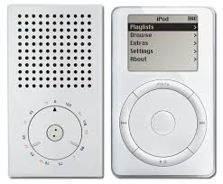
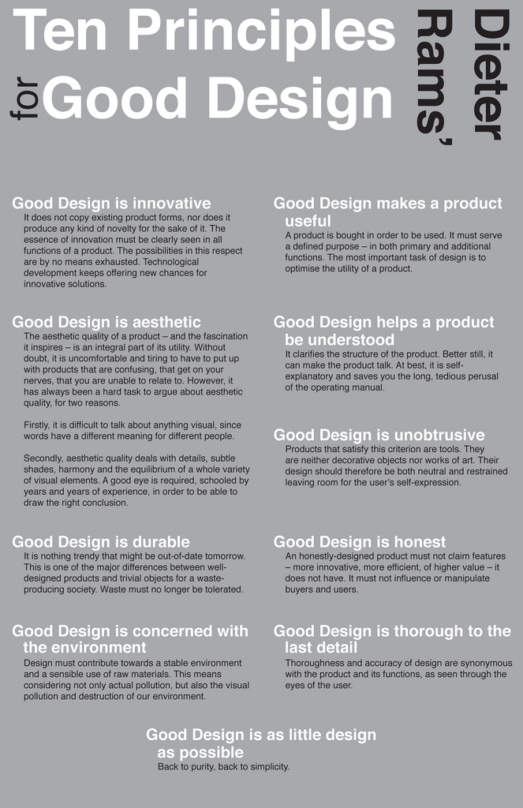
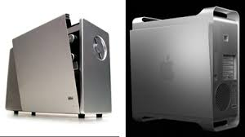
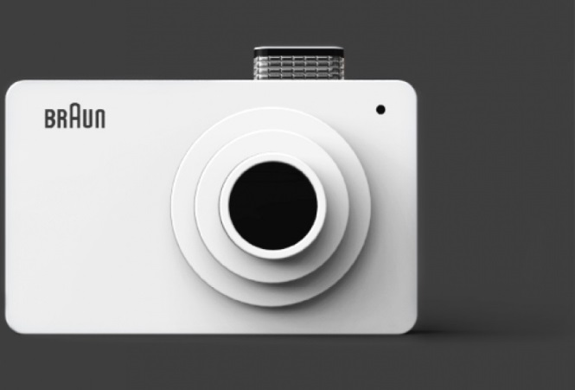
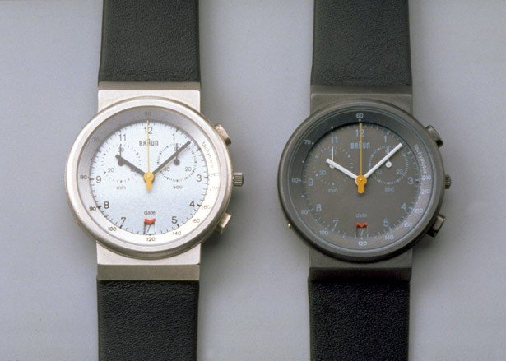
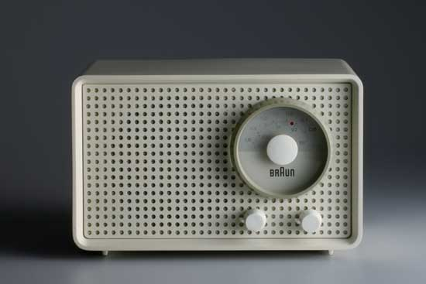
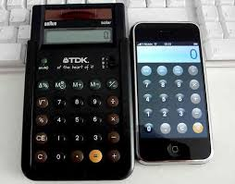

Slide 4
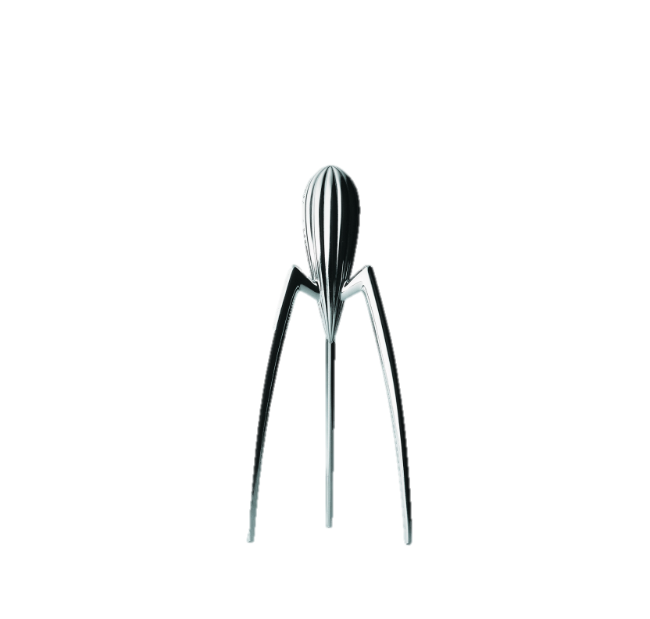
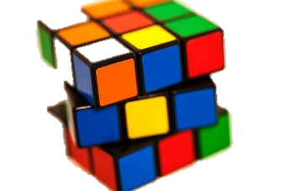
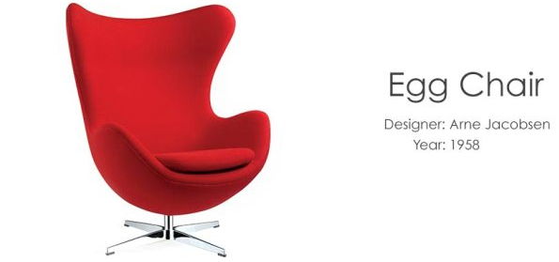
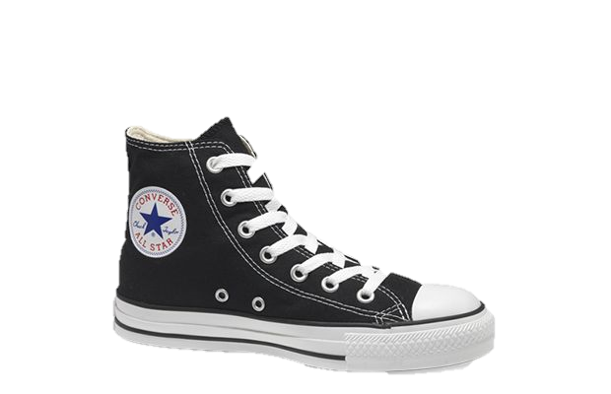
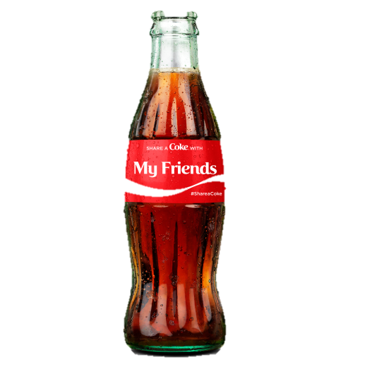
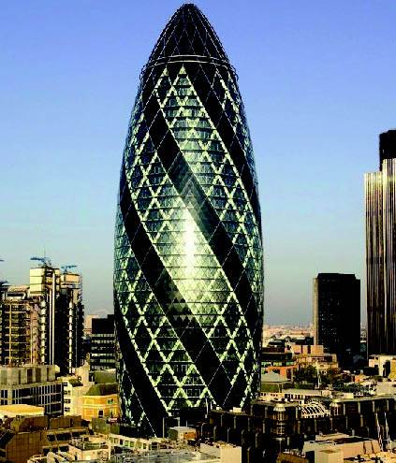
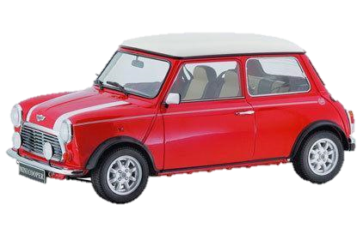
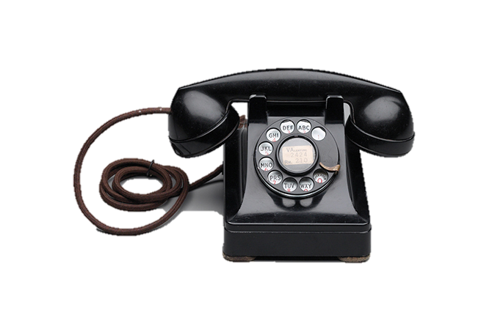
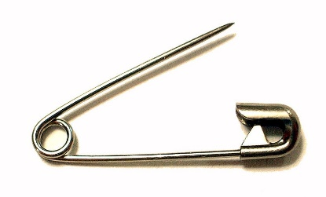

Slide 5
1) From the previous slide, choose which product is the best design and explain why in the space to the left.
2) Choose 3 'Iconic' products from the previous page
Rank each product 10 is best, 1 is worst
Write a brief comment about why it achieved that score.
Add up the rank scores – the highest score is the best design
Use the table provided below.
Product:
Why?
Good Design is: | Product 1 | Product 2 | Product 3
Innovative
Aesthetic
Durable
Environmental
Little as possible
Useful
Understood
Unobtrusive
Honest
Thorough
Total

Slide 6
What is Iconic Design?
1) A design that sets a bench mark for others to follow. 2) A ground breaking design, in terms of its technology or manufacturing techniques used during its production. 3) A design that improves on the past. 4) A design that sets new standards in terms of quality, functions/features or style. 5) A design that stands the test of time, remaining popular despite the passing of years. 6) A design that stays in the memory of those who see/use it. 7) A design that is often recognised immediately by consumers. 8) A design that inspires other designers.
9) Sets a trend. 10) A design that is innovative. 11) A design that is aesthetically pleasing. 12) A design that is often emulated/copied by other designers. 13) A design that has its place in history, or even helps change history.
Use these 13 guidelines for iconic design to choose a product that you think will become a future iconic design.
Remember that a product might not display all 13 guides. It may be especially strong in some and less so in others.
Your chosen product might be a new product that you think 'will' be emulated, 'will' have a place in history etc.
Remember that all products are related to their time and place in history. So your product 'must' have a significant place in todays history.
Product:
Justification:

Slide 7
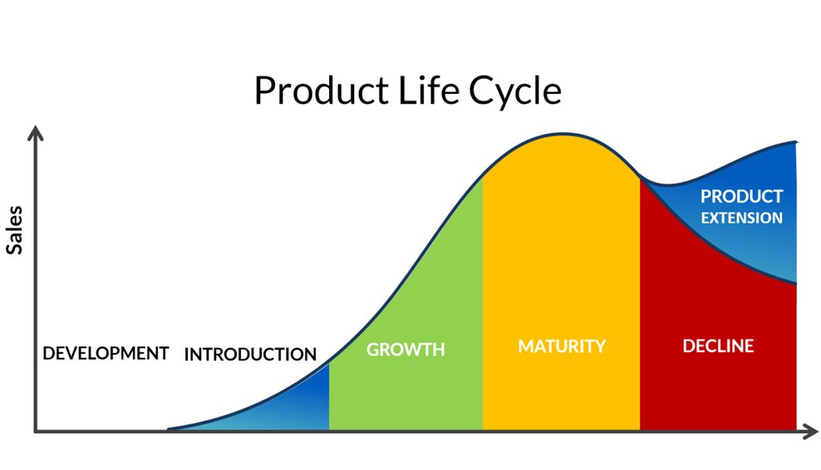
Apple Case Study
Look at the product life cycle chart (left).
Consider Apple’s range of products (Ipod, Iphone 3,4,…....11 etc, Ipad, watch etc)
1) Draw what you think the apple chat would look like at the moment – it doesn’t need to be drawn to scale. (If you can, upload an image in the space provided).
2) What do you suggest Apple needs to do 'now' and why?
Upload image here
What should Apple do ‘now’ and why?
Write answer here

Slide 8
Sketching ideas – Watch this video https://youtu.be/IaPwhWBj77o Have a go yourself and take a picture of the results. Place it below

Slide 9
Design Task
Design a new piece of furniture. Draw your first couple of ideas and take a photograph for this page. You are aiming at a 'Good Design' maybe 'Iconic Design' and well communicated – with some annotation. If you have access to CAD feel free to use that for your ideas if you want to.

